Slide 1
Comparative Analysis of Custom CNN’s v/s Pretrained Image Models Using Federated Learning on CIFAR-10 Dataset
- Group 3

Slide 2
Introduction
Developing a privacy-preserving, scalable models for image classification using federated learning to address data security concerns.
We compared the performance of Custom CNNs and Pretrained Models (ResNet, VGG, Inception) to understand which architecture is leading in terms of performance.
We used CIFAR-10 dataset, one of the most frequently used one to evaluate model accuracy, efficiency, and adaptability in federated setups.
Analyze trade-offs between computational efficiency, generalization, and privacy to identify optimal solutions for secure image classification.

Slide 3
Background
Federated learning enables decentralized model training on distributed devices, ensuring data privacy and security without transferring raw data.
It is applicable in real-world scenarios like healthcare, IoT, and personalized recommendations while adhering to data protection regulations.
Algorithms like FedAvg and FedSGD help improve model training and solve problems like uneven data across devices and differences in device performance.
Privacy-enhancing techniques like secure aggregation computation, combined with pretrained models, improve model performance and generalization.

Slide 4

Federated Learning

Slide 5
Dataset
CIFAR-10 is a widely-used image dataset consisting of 60,000 32x32 color images across 10 different classes, with 6,000 images per class.
The dataset includes 10 classes: airplane, automobile, bird, cat, deer, dog, frog, horse, ship, and truck.
CIFAR-10 is divided into 50,000 training images and 10,000 testing images, making it suitable for evaluating machine learning models.
It is commonly used for benchmarking image classification algorithms and testing models on smaller, real-world image data.

Slide 6
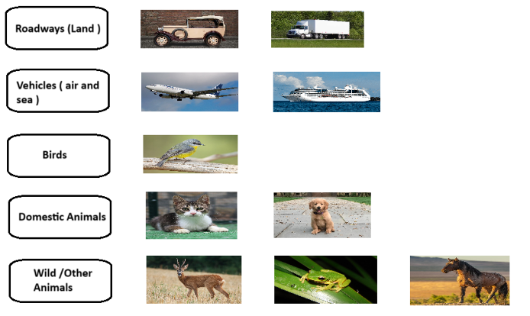
Categorical Distribution of Data

Slide 7
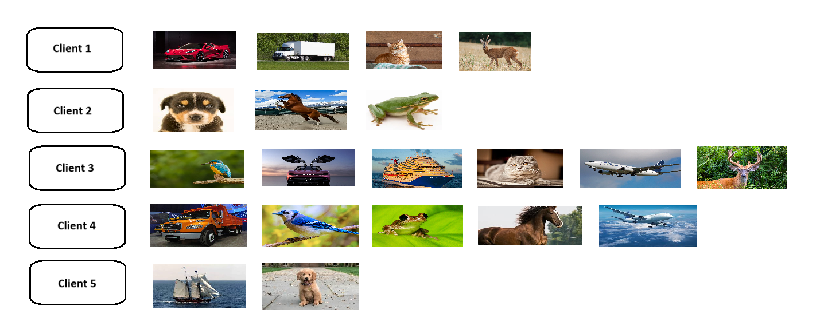
Random Distribution of Data

Slide 8
Methodology
The CIFAR-10 dataset is used, with two types of data distribution: Categorical Data and Random Distributed Data.
Three custom CNN models (Custom CNN 1, 2, and 3) are designed to understand the performance by training on Random data and Category based data.
On the right side, predefined models like ResNet50, VGG16, and InceptionV3 are used for comparison alongside the custom models.
As an overall, we are implementing federated learning on each algorithm on two types of data resulting in training of around 12 models.

Slide 9
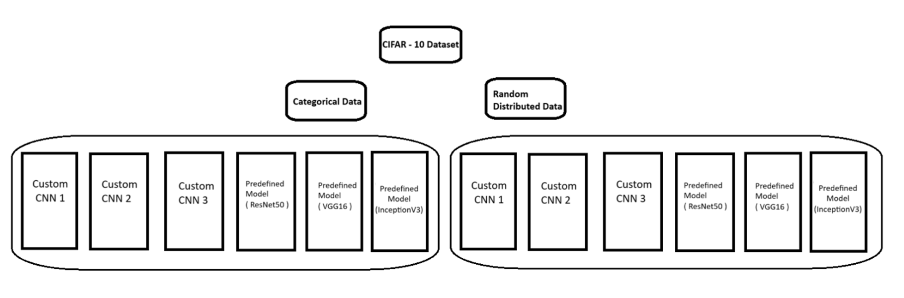
Flow Diagram

Slide 10
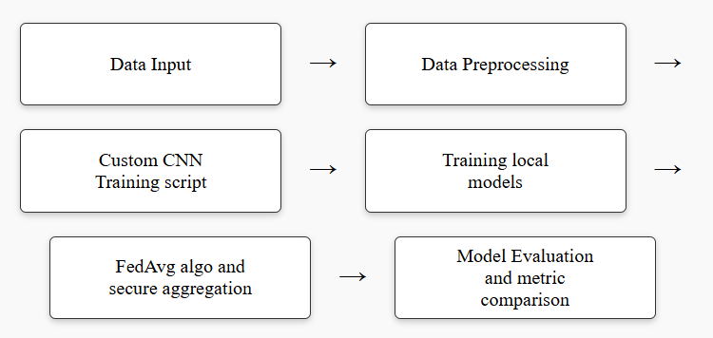
Custom CNN Flow Diagram

Slide 11
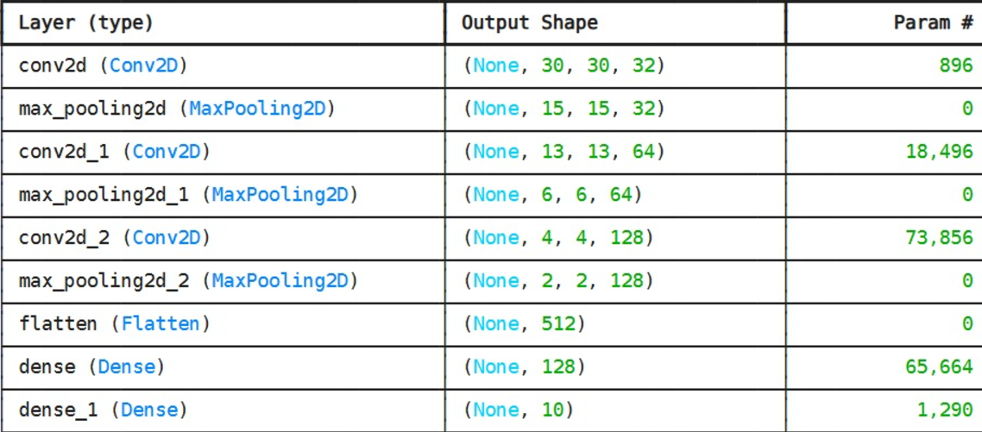
Custom CNN-1
The model has 9 layers, including 3 convolutional layers, 3 max-pooling layers, and 3 fully connected layers (including the output layer).
Input shape is (32, 32, 3), which is reduced through convolution and pooling to (2, 2, 128), then flattened to a 512-dimensional vector.
The final output layer has 10 units with a softmax activation for multi-class classification.

Slide 12
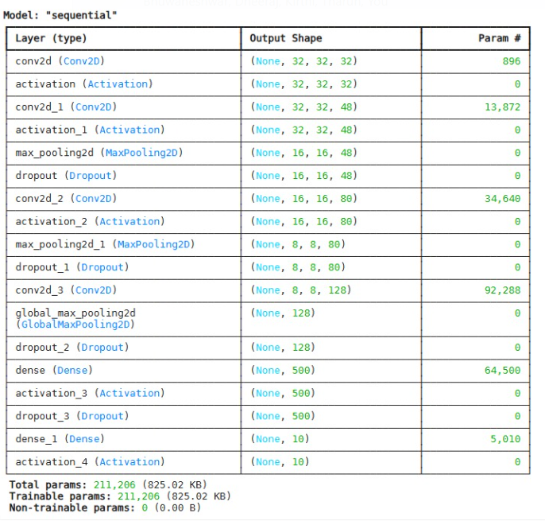
Custom CNN-2
The model has 10 layers, including 4 convolutional layers, 2 max-pooling layers, 1 global max-pooling layer, 3 dropout layers, and 2 fully connected layers (including the output layer).
The input shape (32, 32, 3) is transformed by convolutions and pooling, and then reduced to a 1D vector after global max pooling.

Slide 13
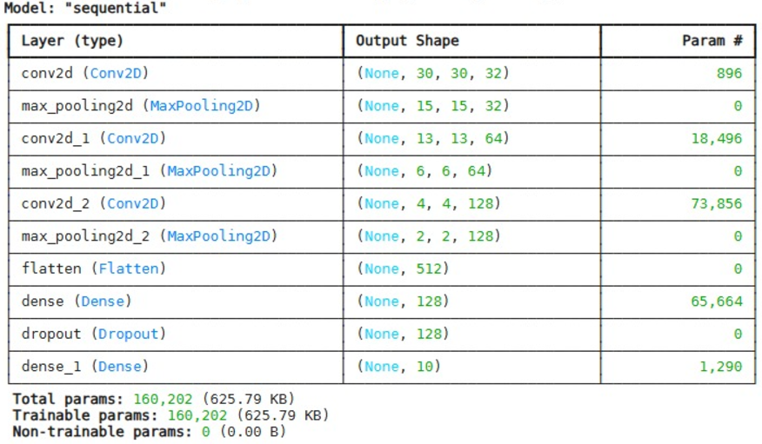
Custom CNN-3
The model has 10 layers, including 3 convolutional layers, 3 max-pooling layers, 1 flatten layer, 1 dropout layer, and 2 fully connected layers (including the output layer).
Input shape (32, 32, 3) is progressively reduced by pooling to (2, 2, 128) and flattened into a 1D vector with 512 units before the dense layers.

Slide 14
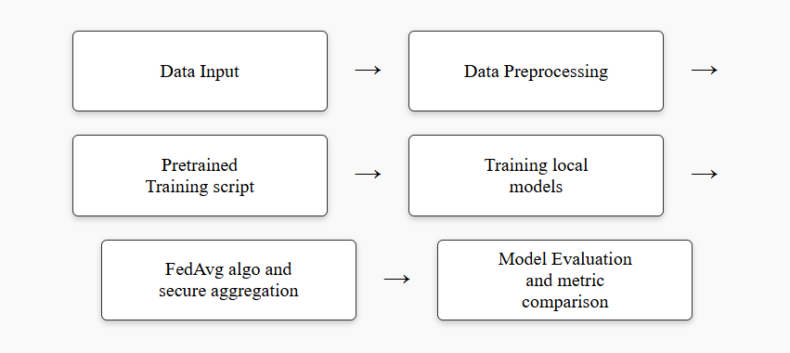
Pretrained Flow Diagram

Slide 15
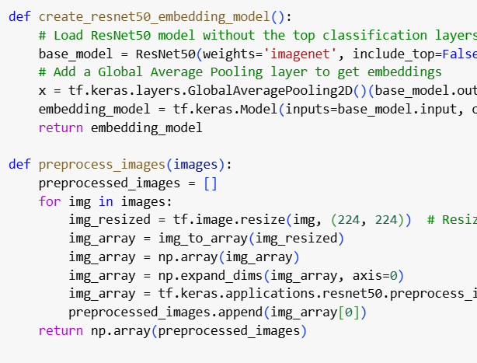
Pretrained-1
The model accepts input images resized to 224x224x3 dimensions to match the ResNet50 input requirements.
The embeddings generated by the ResNet50 model are 2048-dimensional vectors, obtained through the Global Average Pooling layer.
After generating the 2048 vector, we trained a artificial neural networks that was designed to classify on resnet architecture.

Slide 16
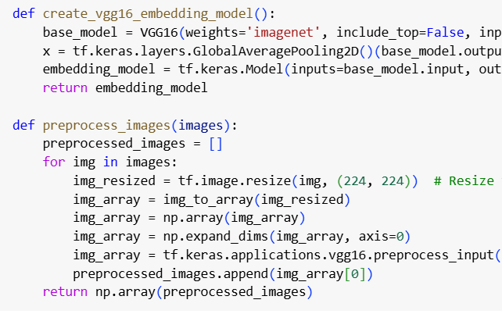
Pretrained-2
The model accepts input images resized to 224x224x3 dimensions, as required by the VGG16 architecture.
Embedding Size: The embeddings generated by the VGG16 model are 512-dimensional vectors, obtained through the Global Average Pooling layer.
After generating the 512 vector, we trained a artificial neural networks that was designed to classify on vgg architecture.

Slide 17
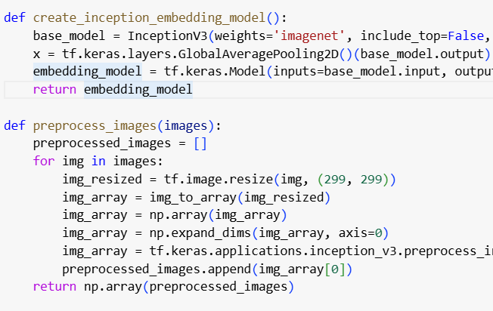
Pretrained-3
The model accepts input images resized to 299x299x3 dimensions, as required by the InceptionV3 architecture.
Embedding Size: The embeddings generated by the InceptionV3 model are 2048-dimensional vectors, obtained through the Global Average Pooling layer.
After generating the 2048 vector, we trained a artificial neural networks that was designed to classify on Inception architecture.

Slide 18
Secure Aggregation
we encoded weights with a constant before transmission and decoded at aggregation, ensuring privacy. In this case we are taking this constant value as 1.
This method protects client data and is computationally efficient while only revealing aggregated updates to the server

Slide 19
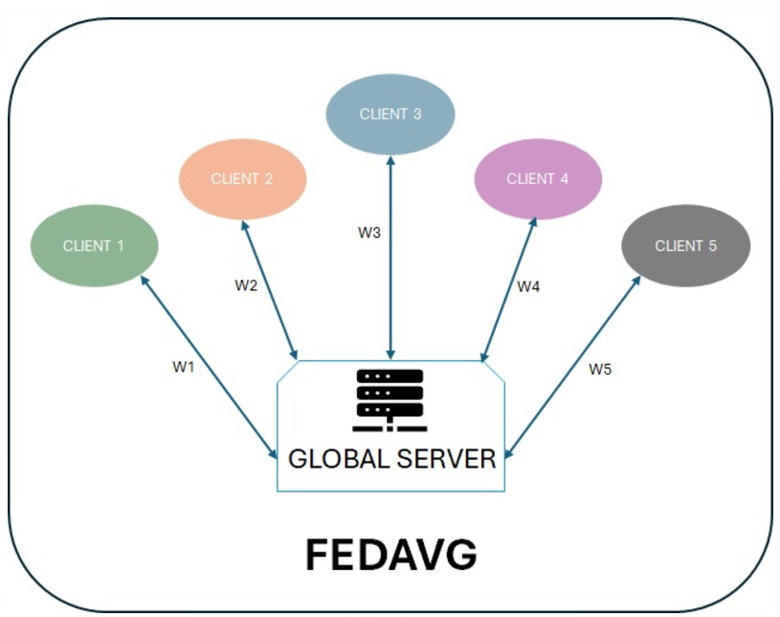
FedAVG
The aggregate_models function decrypts client weights, computes their average using np.mean, and updates the global model with these aggregated weights.
There are other algorithms like FedSGD to update the weights in a different way.

Slide 20
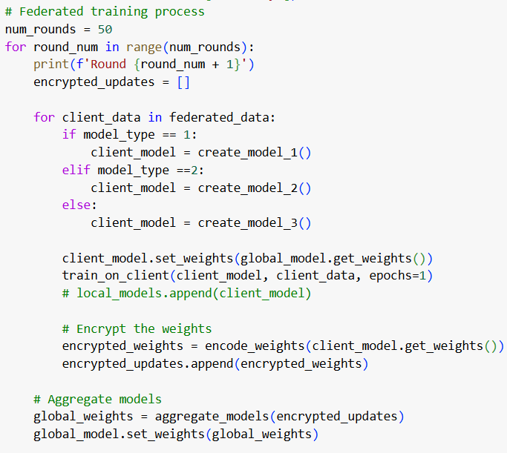
Training Code
Here, for all the 12 models we considered 50 global rounds and 20 epochs for each local training model.
Clients train models locally, encrypt weights, and the server aggregates them to update the global model in 50 rounds.

Slide 21
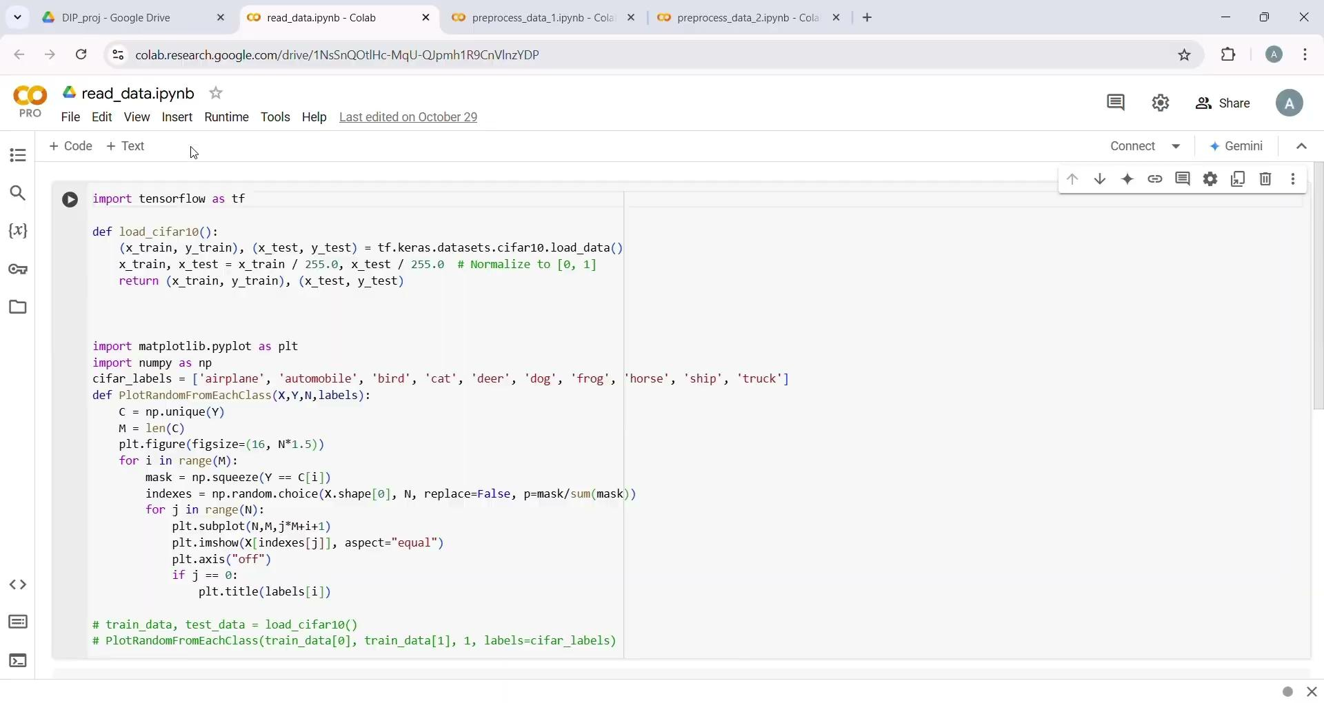
https://drive.google.com/file/d/11EX_yAT82YYLPGCduKiCdEdyn03Ig5BL/view

Slide 22
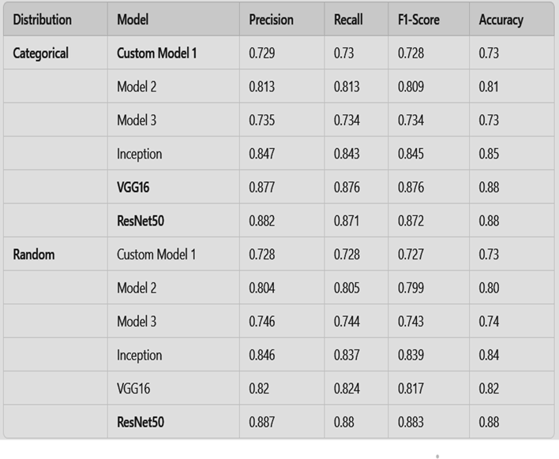
Results
ResNet50 consistently outperformed all models across both distributions, achieving the highest Precision, Recall, F1-Score, and Accuracy.
Pre-trained models (ResNet50, VGG16, Inception) significantly outperformed custom CNNs, highlighting their superior feature extraction and generalization capabilities.
Models performed slightly better on Categorical Distribution

Slide 23


